Slide 1
CLOUD-BASED NLP SERVICE
Milan Ondrašovič - Fabiano Spiga - Fola Ogundero

Slide 2

IBM APIs for NLP/textual analysis

Slide 3
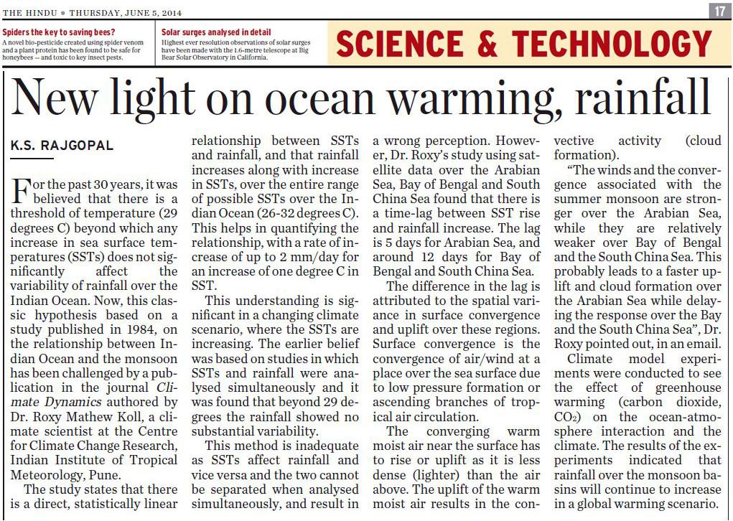
Our goal
A cloud-driven semantic engine for automatic textual analysis

Slide 4
USE CASE: READING LOTS OF ARTICLES?
Let’s suppose a reader who has to go through a long list of articles to be read, summarized, catalogued according to sentiment and translated.
IBM Bluemix cloud natural language processing APIs give the possibility to cluster all these functionalities at once on a single engine to perform text transformation and analysis in one single functionality chain.
We can call the IBM Bluemix API via a RESTful web service.

Slide 5
IBM ACCOUNT MANAGEMENT
SUBSCRIBE FOR FREE CREDIT AND ACCESS IBM BLUEMIX CLOUD SERVICES WITH A STUDENT EMAIL.
OTHER SERVICES REQUIRE CREDIT CARD REGISTRATION (E.G. GOOGLE CLOUD)
THERE ARE LIMITATIONS:
1M CHARACTERS/MONTH FOR TRANSLATION
30000 NLU UNITS FOR NATURAL LANGUAGE SEMANTIC ANALYSIS

Slide 6
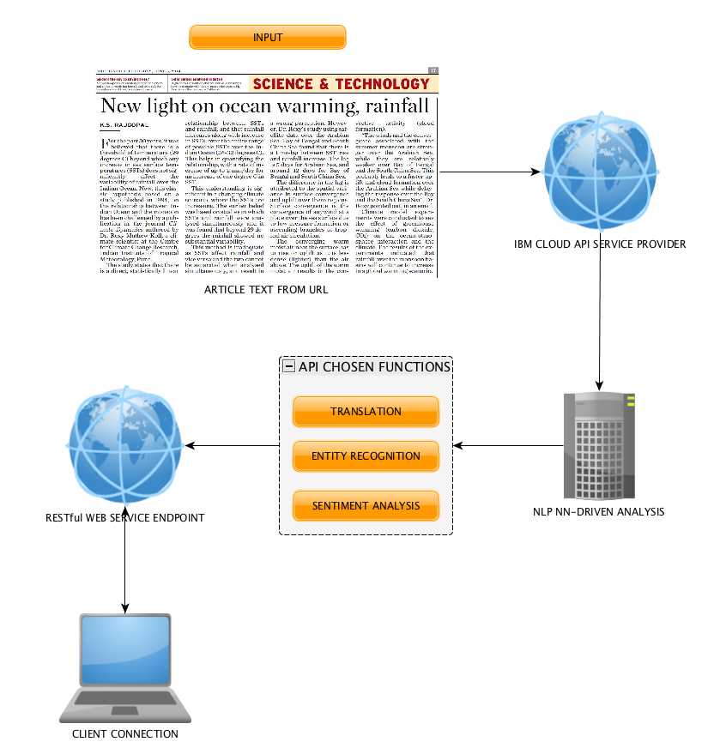
API-DRIVEN
SERVICE
FLOWGRAM

Slide 7
Sample Article
“Neural Networks and Philosophy of Language”
By Massimo Belloni
TRANSLATION
ENTITY EXTRACTION
SENTIMENT ANALYSIS
Further possible textual service additions:
SUMMARIZATION
TAG CLOUD
TEXT TO SPEECH
TEXTUAL CLASSIFIER
CHAT BOT (user’s question/bot’s answer)
https://towardsdatascience.com/neural-networks-and-philosophy-of-language-31c34c0796da
We are using a sample article taken from a website as input text for our NLP API engine

Slide 8
BUILDING BLOCKS
TRANSLATION
It assumes ‘en’ (english) as input and translates to different languages
ENTITY EXTRACTION
Extracts important entities within the text: people, places, organizations, etc.
SENTIMENT ANALYSIS
It outputs an assessment - in terms of ‘positive’ or ‘negative’ quality of the text - along with the intensity of the emotion -
DESCRIPTION
USER INPUT IS DONE THROUGH READING FROM ‘STANDARD INPUT’. THAT MEANS WE CAN USE DIFFERENT TEXT SOURCES, LIKE TEXTUAL INSERTION, FILE UPLOAD, OR URL LINK .
THESE DIFFERENT TYPES OF INPUT CAN BE MANAGED VIA PIPE I/O THROUGH THIRD PARTY PROCESSES.

Slide 9

UI INTERFACE OF OUR SERVICE:
Example of translation:
<app> translate --oper-param de < input.txt
<app> translate --oper-param se < input.txt
Example of sentiment analysis:
<app> sentiment_analysis < input.txt
Example of entity extraction:
<app> entity_extraction < input.txt

Slide 10
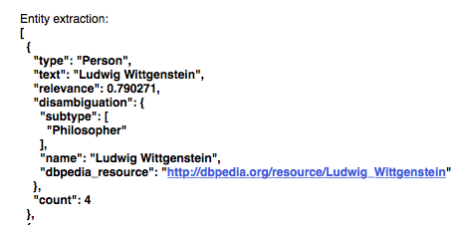

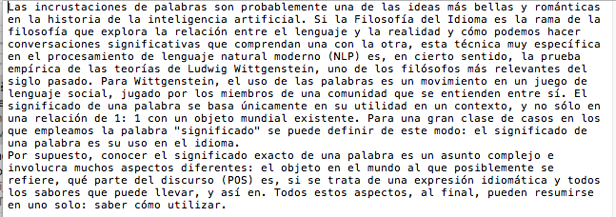
WHAT COULD BE IMPROVED? outputs

Slide 11
WHAT COULD BE IMPROVED?
Another good improvement that could be implemented would be to recommend writers, books or articles based on given output data, for example the Ludwig Wittgenstein output could give related philosophers such as Bertrand Russell.

Slide 12
“Cloud is about how you do computing, not where you do computing.”
Paul Maritz, CEO of VMware

Slide 13
Cloud-based services are more scalable and much cheaper than managing your own data warehouse

Slide 14

Questions?
TIES4911-TASK-7

